Slide 1
Vietnam Veterans Memorial Bandshell
Vernon’s Welcome Home !

Slide 2
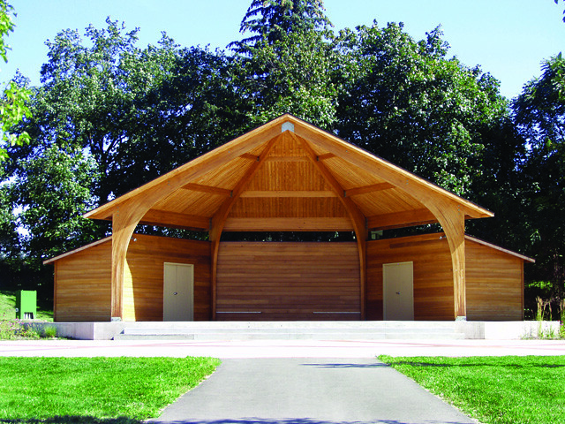
Proposed Band Shell
Wood Construction in keeping with Township Thematic
Elevated for Easier Viewing
Exterior and Interior Lighting for Evening Performances.
Dressing Rooms and Storage.
Ease of Maintenance

Slide 3
Economic Benefits to Township
Provides Community Identity
A “Bridge Through the Ages” with Use From Youngster to Seniors
Music Drives Economic Values To Our Community and Helps Provide Revenues to Our Community
Establishes a Musical/Arts Advisory Board to Help Drive Use and Research Future Funding and Trending Programs
Encourages Broader Support from the Musical and Art Community
Helps to Drive Growth of Musical Tourism with Varied Musical and Arts Programs I.E. Concerts, Competitive Band Presentations, Plays, Recitals and Theatrical Presentations and Movies
Provides a Home for an Engaged and Receptive Audience

Slide 4
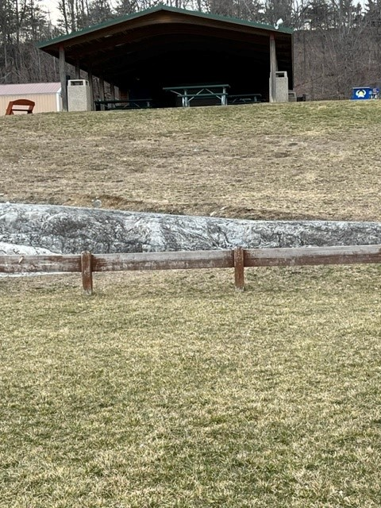
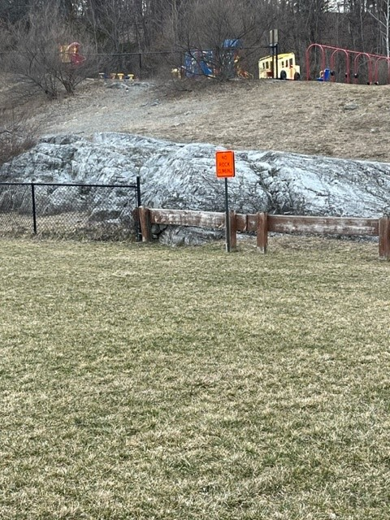
Proposed site: Maple Grange Park
Below Concession Stand
Field Level on Great Lawn

Slide 5
Why Maple Grange ?
Maple Grange is the center of our communities recreation program.
The Memorial Bandshell is designed for use by all age groups and its accessibility provide ADA compliance so necessary for one its primary users our Senior Citizens.
Availability of electrical power, minimal background traffic, central location in center of town bounded by Rt. 94 and County 517, potential for increased growth and parking.
Level Siting area requires minimal elevation of bandshell for satisfactory audience viewing.
Restroom facilities available at field level and at concession level.
Field level affords handicapped seating and emergency access.

Slide 6
Cost to Vernon Township
At this point all costs are close approximations based engineering estimates.
Total cost estimation would be approximately $400,000 plus planned labor participation by DPW. That amount toe be determined.
Final costs would be developed after specifications are approved prior to bidding.
Structure is a depreciable project so a life span can be imputed based on projected interest rates hence the benefits of BAN’s.
Projected $400,000 cost with $125,000 cash down payment and $275,000 debt financing with Bond Anticipation Notes cost to Average Home per year would be $3.43 per year or 29 cents per month.

Slide 7
A Unity Project: What Financial Support Have
We Raised?
Our Loyal Business Supporters
Crystal Springs- $10,000 Grant
Mountain Creek- $10,000 Grant
KKG Corporation- $5,000 Grant
RS Philips Steel- In Kind Donations estimated - $3000.00
Private Community Donations
Individual Pledges $3,000
Donations- approx. $500.00

Slide 8
Why Now??
Vernon Township needs to develop a cultural base to recognize the passive recreational demands of its growing Senior Citizen population.
Vernon Township will benefit from the communal support of the varying programs that will be presented.
The Memorial Band bandshell will provide Vernon Township with a strong sense of pride in recognizing its commitment to the Arts.
It will be Vernon’s recognition of the Vietnam Veterans and their powerful achievement of a place of final rest for their fallen brothers and sisters. Why have them wait any longer?

