Slide 1
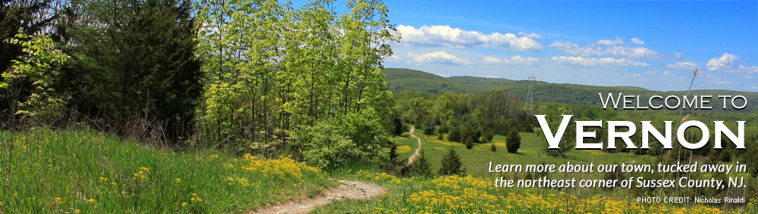
VERNON TOWN CENTER
TRAIL
&
BICYCLE PUMP TRACK
Notes:
Thank you for joining us today
My name is Andrew Pitsker, I sit on the town council now for the last year and it is an honor to serve you and also be part of this presentation
I am here today to present to you the Economic plan and justification of the Vernon Town Center Trail & Bicycle Pump Track proposal.
I will walk you through the Why do this, the Vision, the economics and share with you some conservative revenue calculations an some sources of how some of this material was developed.
All of this material, along with a FAQ File will be available on the town site

Slide 2
WHY?
Build a family oriented centralized park
Bicycle Pump Track (BPT) & Trail to connect people to Town Center (TC)
Businesses opportunities
If we don’t invest in our town, who will?
Notes:
Why do this?
From a Family perspective, this is a way to bring families together, a gathering place for social interaction and a place where you can enjoy the view of the valley vista.
Also this is a start in developing a connection. By connecting people and town together. This is an opportunity to develop Town Center and as studies show, a Park is a central part of a town.
This is a plan, a plan to develop business opportunities as well. Realistically, if we don’t invest in our town center, who will?
I recall we need to increase our ratables, grow business and most importantly provide for the wellbeing/safety of our population of Vernon Township

Slide 3

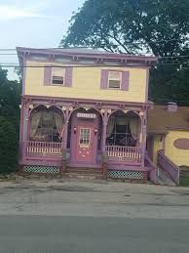
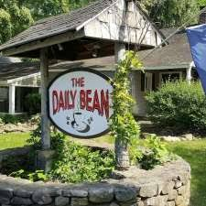
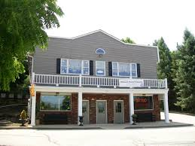

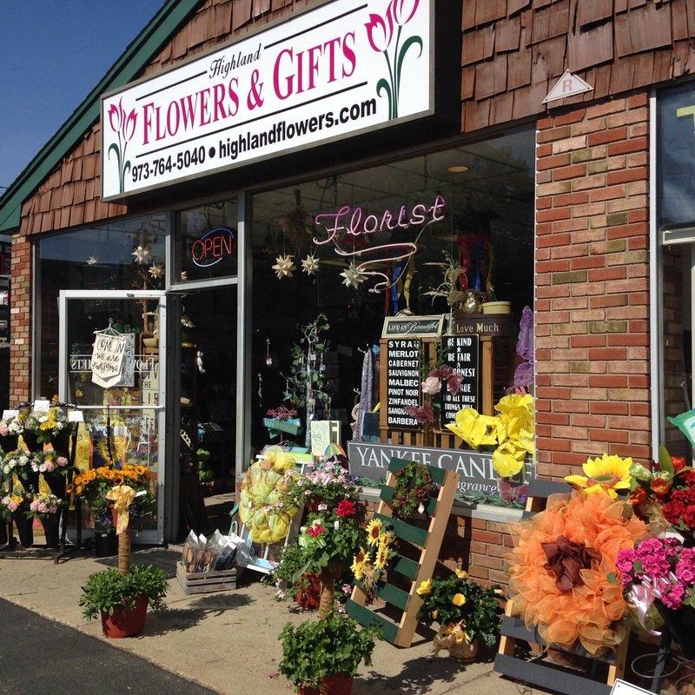
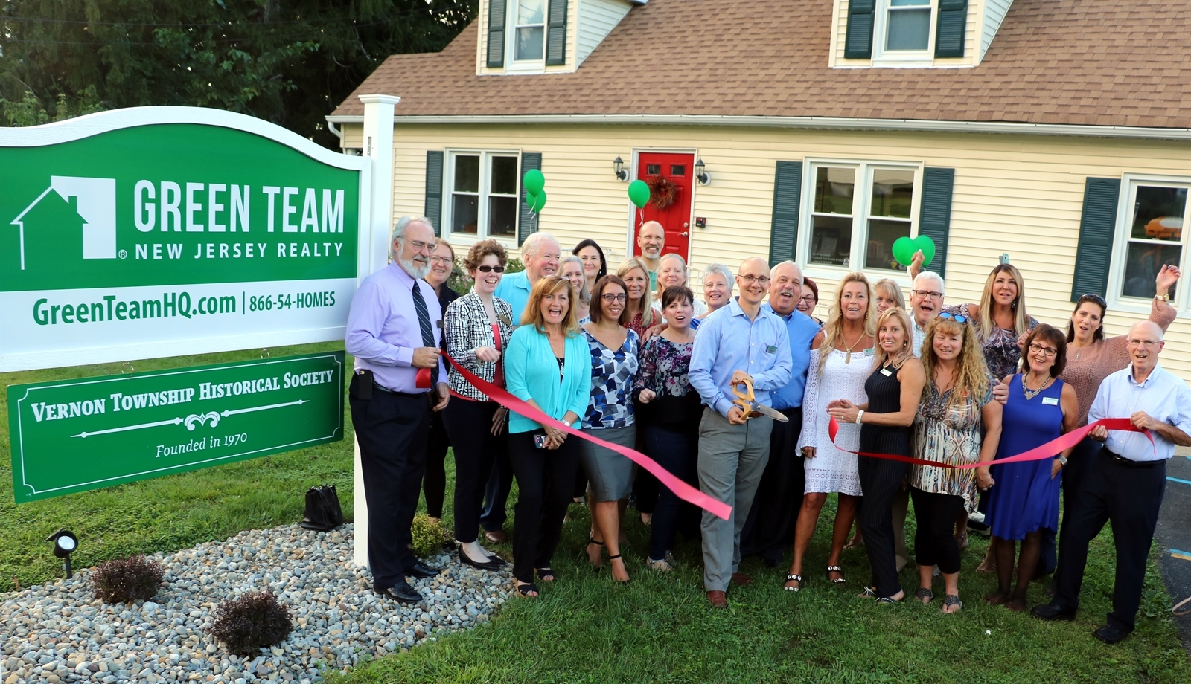
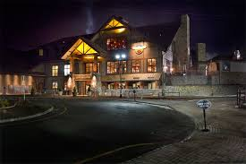
Connect People with Local Businesses
Notes:
All of these business are here today, how many can we connect to Town Center?
How many more can we attract?
This is one solution. Others will come, if we do something.
But it has been many years, since we have done anything to develop Town Center.

Slide 4
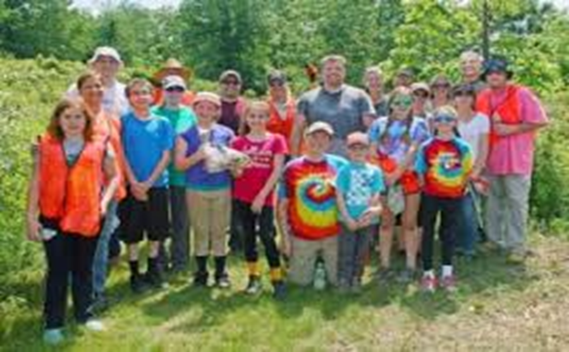
Vision
Create a healthy and vibrant community
New passive and active recreation activities.
Economic Driver for vacant parcel development.
Notes:
What is the visions
Read from slide
These are all well documented in many studies and research. I will be sharing all those links with you in this presentation
Keep in mind, we have much more to do behind the scenes as we work through this plan.
We have to still develop a Marketing Strategy working with our Economical Development Advisory Committee,
It is obvious we need to Market VERNON Township more effectively in the future.
Most of all we need to attract, retain new businesses so we can grow, prosper and increase our ratables.

Slide 5
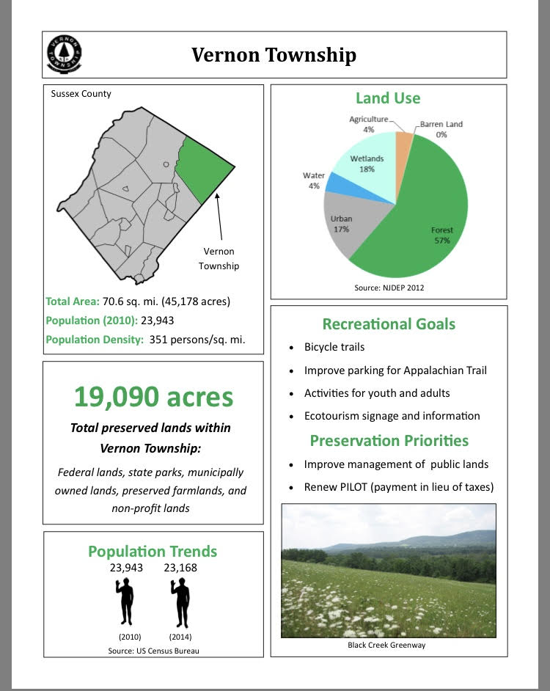
Considerations
Economic Benefits
Master Plan
Community Activities & Events
Construction Cost
Maintenance Cost
Insurance Cost
Notes:
What are the considerations we need to look at?
I will try and touch on all of these points during this presentation.
We have a FAQ file that captures many of the questions asked in the last days, months and years. This to is available for your review.
This FAQ file will be a living document as well as we continue to receive questions, understand your concerns and find solutions to go forward…. Together.
We need to answer the tough questions so we all benefit to investing with responsibility.
While understanding, we are doing this for the Benefit of Economic Growth and a secure Vernon
And hopefully improving our ratables in the future.

Slide 6
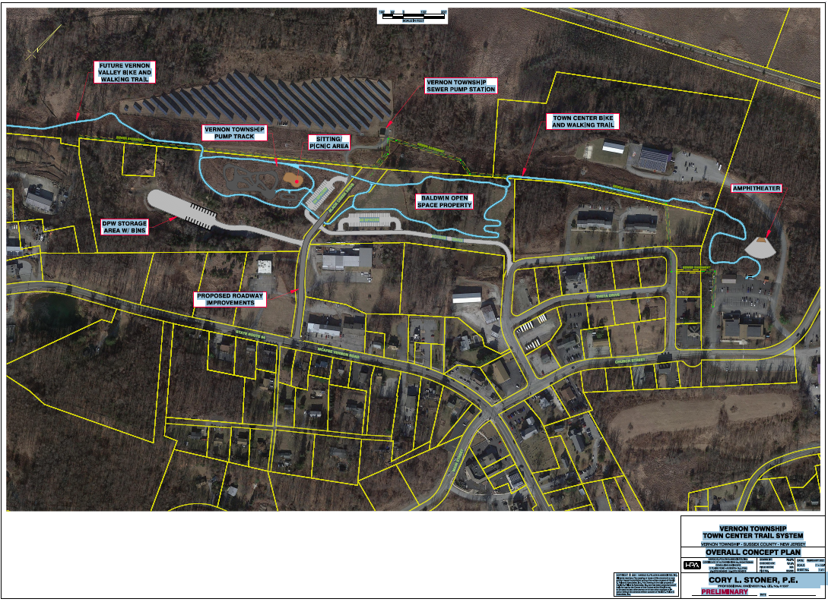
Notes:
As this has been presented earlier,
This is the Vision!
Track, Trail & Community,,,,, Coming Together for a Better and Stronger Vernon.

Slide 7
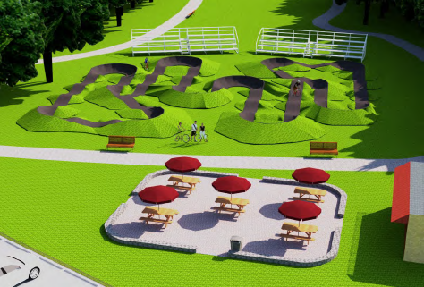
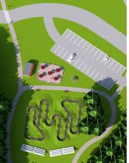
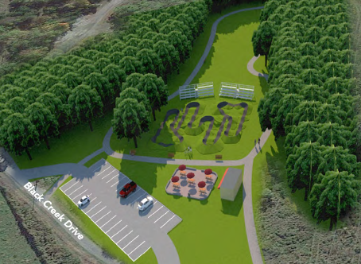
Notes:
Keep in mind, This is a Vision, A Plan, A Journey & YES an Investment in our town.
One not to take lightly and one that can grow Vernon in a smart way

Slide 8
Trail System – Key Economic Benefits
Increase value of adjacent properties
Communities along trails, often called trail towns, benefit from the influx of visitors going to eateries and other retail establishments
Trails make communities more attractive places to live.
Economic growth is well documented
  Trail systems attract new businesses
  Provide new economic opportunities for existing businesses.
Source; Link : We Conserve PA
Notes:
Now lets go over the economics. (Read from Slide)
These are a highlight of the Key Economic benefits. These are well documented by various studies and by many states, The We Conserve PA is just one. Go to any state and you will see that all towns look for these types of developments and Track & trails are a big consideration in keeping towns active, healthy and economically stable.
Note, In this presentation I have provided many LINKS for your reference.

Slide 9
Economic Benefit – (cont-2)
Studies show
Boost spending at local businesses
Revitalize depressed areas, creating a demand for space in what were once vacant land/buildings.
Provide low or no-cost recreation to families with low costs relative to other recreational services that could be provided by government.
Increase tax revenues in the communities in which they are located.
These benefits represent a huge economic return on the money invested into trail projects. The costs of land acquisition for trails, trail construction and maintenance are far outweighed by the economic benefits generated by trails
Resource ; https://conservationtools.org/guides/97-economic-benefits-of-trails#heading_2
Notes:
Read from slide and here is another Source
Here are some other points I found from other sources
The Economic Benefits of Trails
American Hiking Society
Trails allow communities to increase commerce, support and create jobs, increase property values, reduce commuter costs and provide low-cost health benefits.
It took only one season after the opening of the 35-mile Missouri River State Trail for the trail to positively impact local communities. After one season, 61 businesses along the trail found the trail positively impacted their businesses. Eleven reported the trail strongly influenced their decision on where to locate and 17 increased their business size since the trail opened.
The Washington State Trails Plan estimated that trail users in Washington state spent more than $3.4 billion on equipment, which generated tax revenues of $13.8 to $27.6 million.
Along the Baltimore and Annapolis Trail Park in Maryland, six trail-related stores have opened and two others have re-located next to the trail to attract new customers.
In a 1995 survey, 73% of metro-Denver real estate agents believed a home near a trail would be easier to sell. Twenty-nine percent of those living near a trail said proximity to a trail influenced their home purchase.
Fifty percent of all car excursions are less than three miles, a distance that could easily be walked or biked. The use of trails instead of cars reduces gas and auto care costs and improves air quality.
Walking or hiking a few times per week can improve a person’s health and lower health care costs. A National Park Service study compared people who lead sedentary lifestyles to those who exercise regularly. The exercisers filed 14% fewer healthcare claims, spent 30% fewer days in the hospital, and had 41% fewer claims greater than $5,000.

Slide 10
Economic Benefit – Local Businesses (cont. -3)
Four in ten trail users that were surveyed planned an overnight stay as part of their trip.
Overnight trail users spent an average of $98 a day in the trail communities. (not including accommodations)
Non-overnight trail users spent an average of $13 a day in the trail communities.
Average income from 60 people per week day trips 60 X$13 = $780 x 52 weeks = $40K annually in day trip spend.
Average income from 6 people with overnight stays for 2 days, plus meals = $98 per day x 2 days x 6 people x 52 weeks = $60K annually
Resource ; https://conservationtools-production.s3.amazonaws.com/library_item_files/1075/985/CT_Eco_Ben_Trails_111114.pdf?
Notes:
How do Local Businesses benefit?
Here are some examples ( Read from Slide)
These are very conservative estimates, but they give you a formula for you to develop your own picture of what the economic impact could be.

Slide 11
Economic Benefit – Town revenues Projected
Currently on Church Street , Theta & Omega, there are 14 properties vacant
If two properties are sold and developed ( ½ - 1 Acres in total)
  Revenue could increase from $4K to $8K just in taxes
  If one property develops every 2-3 years, revenues increases a minimum of $4K / year per property
  We need to grow tax ratables businesses in town center
Potential tax revenue increase to develop these three streets in 10 years = 14 lots X $4K/year per lot = $56K per year more in tax revenue
Notes:
Town Revenue comes in the form of Ratables doesn’t it?
When a piece of vacant property is developed, it grows in value, value brings higher assessment and this in turn brings more tax income to the town.
We also grow tax income in other ways,
But what is most important, we grow as a town, we bring work on stabilizing the tax burden with future growth.
It also brings local jobs.
Very conservative numbers, actual charts show much higher.
We utilized these numbers so as not to get into a debate on the value.
Lets take one simple Example
A piece of vacant property on Church street has a tax bill of 4,000 Dollars
A similar piece of property on Church Street with just a building with offices and apartments has a tax bill of $14,000
So the numbers on this slide, are very conservative in comparison to what is on Church Street today.
Why did we do this, Antioption of maybe a PILOT, Maybe other incentives will have to be considered.
All in all, We stayed on the conservative side

Slide 12
Economic Benefit – Town revenues Projected (Continue)
Supports Sewer Service Expansion
  More EDUs for our Sewer System
  Spreads the cost over a larger user base
  Improves the utilization of the system
  Stabilizes rates for the future
Notes:
Other considerations include what will happen to the Sewer System

Slide 13
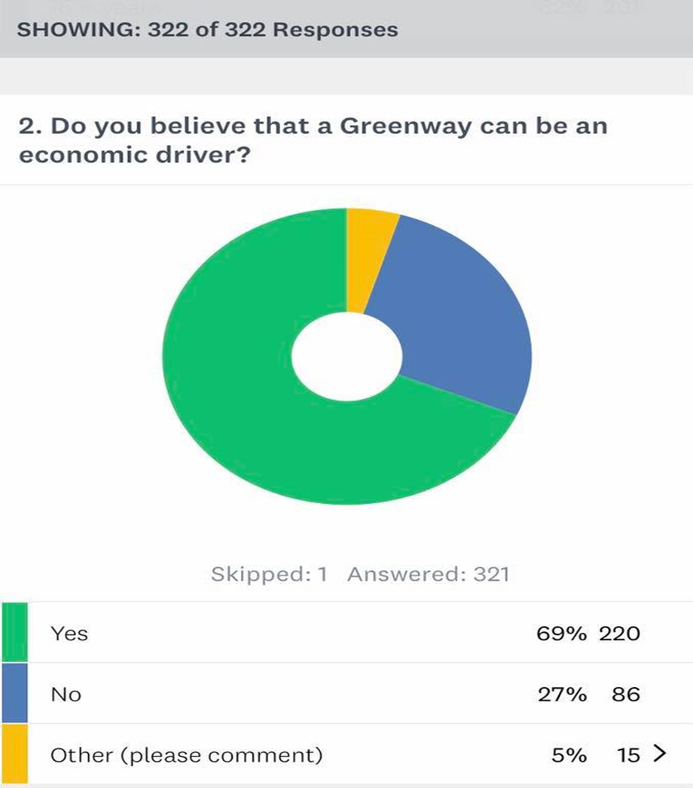
Trail System – Key Economic Benefits
Notes:
Many Surveys confirm these findings.
Statistics validate them
They appear similar to when we have had the referendum on approval for the Open Space moneys back in 2018

Slide 14
Open Space Trust Fund
Current Total Open Space Funds $858,000
  Approved via 2018 referendum for amenities i.e. trail & BPT - $291,000
    Continue Funding-6% of Hotel Occupancy Tax
Current Available for Acquisition & farmland preservation- $588,000
    Continue Funding-1% of Hotel Occupancy Tax
Notes:
Lets go over some financials, and try and sort out the details
What is the fund balance, and where is it being utilized?
Currently the Balance is as stated
70% is still set aside
30% was approved back in 2018/2019 to be utilized
While at the same time we continue to feed the OSF from STR or HOT
Continued Funding-6% of Hotel Occupancy Tax -revenue for creation and maintenance of public pathways for hiking, biking and horseback riding trails; gardens, disc golf, amphitheater, bike pump track; and cultural sites.

Slide 15
Estimated Cost for Project Construction
Estimated Trail Construction - $245,000
  Includes ADA compliant section cost of $50K
  Trail is both biking and walking
Estimated Bike Pump Track - $170,000
TOTAL PROJECT COSTS - $415,000
Notes:
Lets look at the Estimate cost of construction
This is the cost of construction of the actual Trail and Track

Slide 16
Other Cost for Project Construction
Road improvement of Black Creek = $225,000
Access road Omega to Black Creek = $200,000
Paved 30 space parking - $60,000
Road & Parking improvements - $485,000
Notes:
Other cost are regarded as part of the total project for safety and improved access.

Slide 17
Total Cost of Full Project
Trail & BPT construction cost = $415,000
Road & Parking improvements and additions = $485,000
Baldwin Open Space Acquisition = $289,000
Total Project Cost = $1,189,000
Notes:
Here is the total project cost before any other funds/grants are considered.
Now lets go to how this is planned to be financed

Slide 18
How will this be financed?
Down Payment from Capital Funds = $29,000
Open Space Funds from 2018 Ordinance = $291,000
Open Space Funds Baldwin Property
  Vernon Open Space Funds = $214,000
  Sussex County Open Space Fund Grant = $75,000
Bonding for road improvements & trail additions = $580,000
Notes:
How will we finance this.
By using Open Space Funds, we are financing 49% of the project.
51% comes from Open Space Monies
This represents a good investment and maximizes our utilization of Open Space funds for helping grow Vernon and support the Open Space objectives
Other Grants are being filed as we progress on this project
OPF collected from 2000-2005 and most of this is from interest over the years

Slide 19
Why Finance?
Bike Pump Track & Trails long life- 15 years
Bond rate is low, 3.95% anticipated average
If financed, BPT & trail system will cost the avg. household approx. $5.80 a year for 10 years
  Less if interest rates remain low
Notes:
3.95 is an average
Current Short term rates are less then 1% as or May 2021
The 29K comes from the current capital improvement fund
Currently we have 600K plus in Capital Improvement funds. ( Check with Donelle )

Slide 20
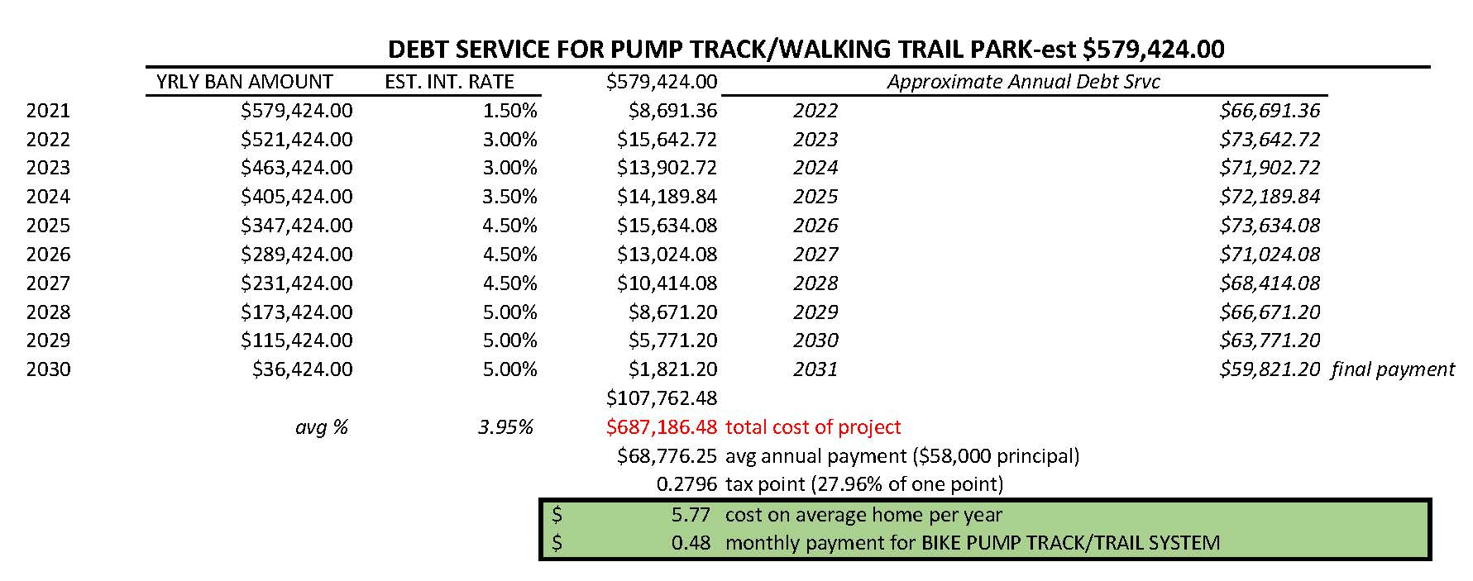
Total Project: $1,189,000 ($29,000 down payment+Open Space Funds); BAN total approx. $580,000 w/projected useful life = 15 yrs.
Total cost per home if we took debt for the pump track would be $1.48 each year for 10 years.
Notes:
Here is the amortized schedule.
It is a 10 Year bond based on average interest rate of 3.95%
Donelle can you comment on this chart?

Slide 21
Potential Revenue streams for local businesses and potential ratable growth
  Tax revenue from new construction and business growth = $18K - $88k
  New business opportunity and organic growth of existing business = $15K
  Revenue stream increase = $103K - $173k annually from Track and Trail activity
  Properties sold and developed beyond the conservative estimates
  Events at the site that can be developed
  Others
Notes:
These are some revenue streams that can be considered and create an increase in growing Vernon and attracting more development.

Slide 22
Payback calculations not established
(Small amount considered in the first year)
Income to local existing businesses
Tax revenues from Short Term Rentals
Tax revenues from new businesses
Tax revenues in property purchases and improvements
Increase in local employment
Increase utilization of the sewer service area
Notes:
Some payback calculations not considered and could help improve this picture mores are as follows

Slide 23
Why do this?
Need to invest in Town Center to bring in new business
  No real activity based investment in many years
Promote growth by attracting new businesses to buy and build in Town Center
Many studies support towns thrive when parks/trail are built.
Promotes healthy town initiatives
Revenue growth as business grow and build.
  Example; 5 building lots sold, built on and operating, we increase tax revenue by at least $20k -50K annually
Notes:
So why do this?

Slide 24
What if we do nothing?
Tax burden increases on each household
  Because there are no Tax ratables to help share the burden
No economic growth of the town or the town center
  What have we done in the last 5, 10, 15, 20, 30 years for Town Center?
We then rely and hope business will do this themselves and we will benefit from it
We are not committing to a plan or a solution
We are not promoting growth
Notes:
Read from Slide

Slide 25
Concerns
What are the cost for Maintenance for the Track & Trail ?
  Varies. Estimated @ $10,000 year
Insurance Impact?
  None, we are a member of the Statewide Joint Insurance Fund & State Law
Chapter 59 provides some tort protections.
  This provides immunity for townships/government entities for issues where private insurance would require additional payouts due to liability
Notes:
Here are some of the concerns and also included in the FAQ’s
Maintenance come out of Open Space funds

Slide 26
Future Vision
Town Center Park & BPT is only a small part of a vision.
Opportunity for utilizing NJ Trail system concept.
North West trail system that connects, TC to Appalachian Trail, Warwick, and Hardyston.
Catalyst to a trail system connection of the western side of NJ/PA.
  Link to NJ Trails Plan
Notes:
In summary

Slide 27
Additional Sources
Economic Benefits of a trail – We Conserve PA
Economic Benefit PA Land Trust Association
The Economic Benefits of Trails - American Hiking Association
The Economic Impact of Greenways and Multiuse trail.pdf
NJ Trail Plan Update 2020
Notes:
Here are some of the other sources,
All of these you see are hot links, so when you download the file you should be able to click on the link and find the information for yourself and form your own consensus if this is a valid solution.

Slide 28
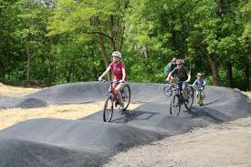
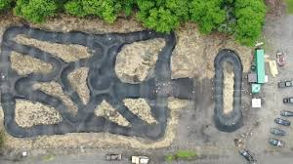
Bicycle Pump Track
Notes:
The road to growth and development is never easy. There are many ups and downs, but if we plan, discuss and execute, we can grow Vernon and increase growth in bringing in new businesses, stabilize taxes in the future and grow the ratables.
People have come forth asking for this, and some of us thought they could be done at no cost.
But obviously, cost and commitment come into play, but we as a town can come together and invest in our town together.
Therefore building something in town center to help us grow and something for us to be proud of.

Slide 29
VERNON TOWNSHIP
Future growth
A Stronger Vernon
Notes:
It is up to all of us, This is one solution, A solid one talked about for many years, and now it is doable. The plan is not complete yet and still needs more work.
I look forward to a civil discussion and work toward this and other solutions to bring Vernon a stronger business platform and flatten the taxes in the future.
Thank you for listening to me, Hopefully this will give you more information on which to form your own opinions and get a better understanding of where your Town Government is trying to achieve.
But it take all of us working together and I value all of your thoughts and opinions, but it does take solutions, ideas and hard work to make this or anything to happen.
So if you have ideas/solutions I look forward to a meaningful dialogue,
If you disagree with the plan, I look forward to ideas on how we can make Town Center better,
But if we are going to do anything, We all must be part of the solution
For me, I believe it is time to invest in Vernon’s growth and benefit all of the people in this town, Now and into the future.
Thank you – Thant concludes my part of the presentation – Back to you Howard.

